Slide 1
Code Management
EC601

Slide 2

Real Life Scenario
Mistakes
Credit https://s-media-cache-ak0.pinimg.com/736x/3a/11/68/3a116884945f870924f1ffd3f36fc015.jpg:

Slide 3

Real Life Scenario
Things Happen
Credit http://4.bp.blogspot.com/_njw9zr0m21k/TQposqJcLYI/AAAAAAAAAZk/aLICy2jKvJI/s1600/Computer+Crash.jpg

Slide 4

Real Life Scenario
Bugs
Credit: http://blog.qatestlab.com/wp-content/uploads/2012/04/Preventing-of-Software-Bugs-and-Bug-Sources-1200x545_c.gif

Slide 5

Real Life Scenario
Things Happen
Credit http://2e8ram2s1li74atce18qz5y1.wpengine.netdna-cdn.com/wp-content/uploads/2017/03/Android-Google-Campus-Dice-1024x572.jpg

Slide 6

Real Life Scenario
Working with others
Credit https://www.oracle.com/assets/cw24-java-info-bkgd-2244997.jpg

Slide 7
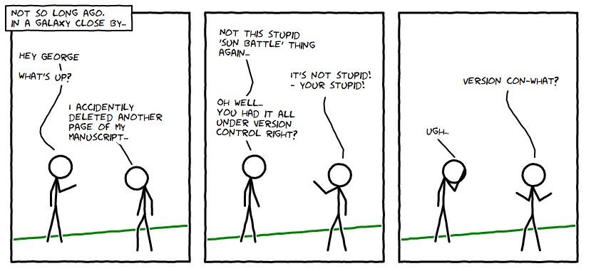
Credit: http://smutch.github.io/VersionControlTutorial/_images/vc-xkcd.jpg

Slide 8
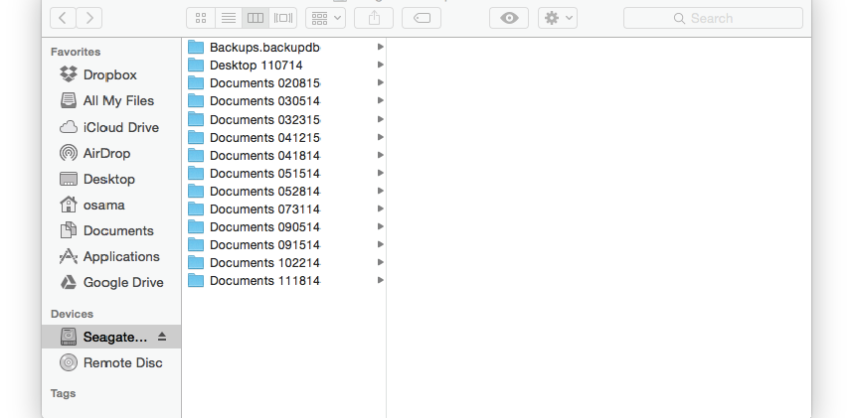
One way to do it …..

Slide 9
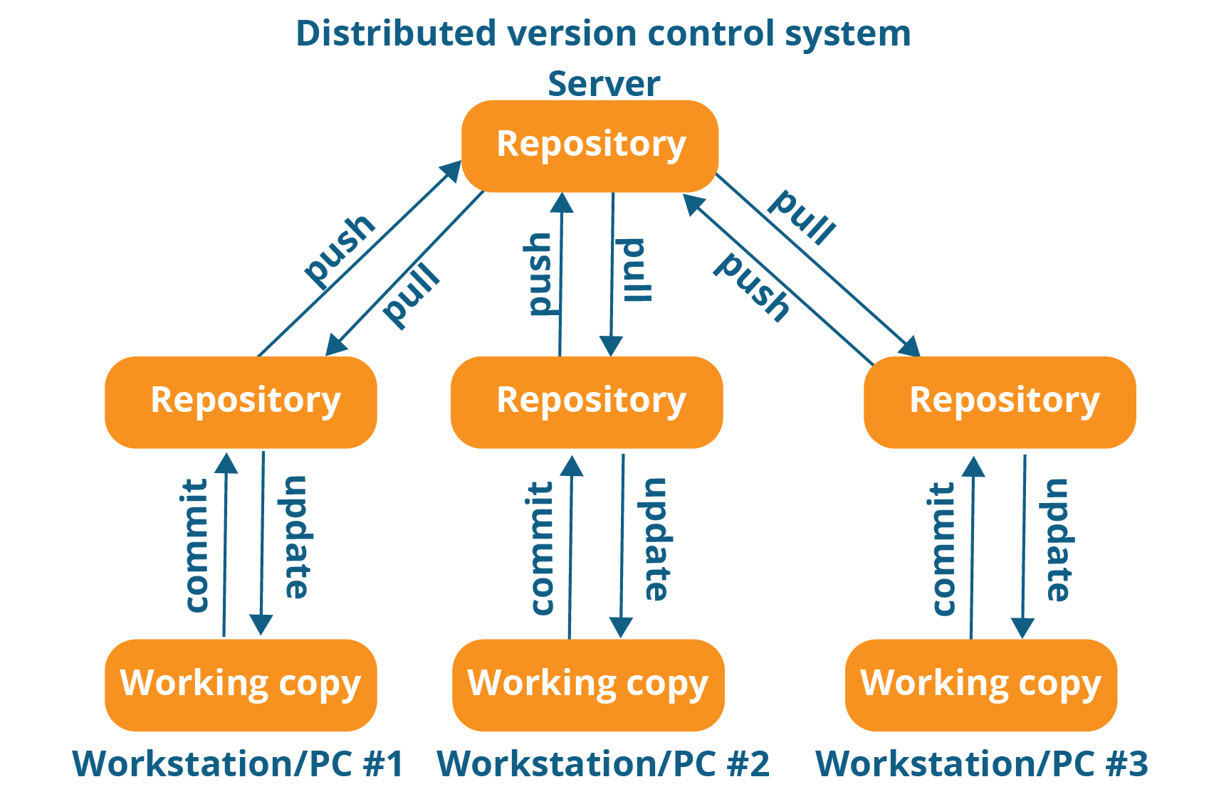
Version Control System
Credit: https://cdn.edureka.co/blog/wp-content/uploads/2016/11/Distributed-Version-Control-System-Workflow-What-Is-Git-Edureka.png

Slide 10
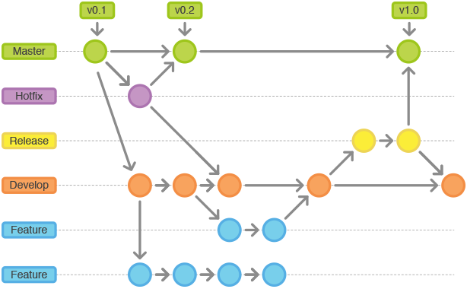
Examples of how it works
Credit: https://i.stack.imgur.com/ZVqYX.png

Slide 11
List of Code Management Systems

Slide 12
Tutorials
Udacity Free Class → Recommended by previous year students.
GitHub
BitBucket
LearnCode Academy
LearnCode GitHub Tutorials

Slide 13
Please master these skills
Creating a project
Pull (check out)
Push (check in)
Branching
Merging
Conflict resolutions
Best way to learn is by doing it and reading documents

Slide 14
Homework 1

Slide 15
Thank you

